Slide 1
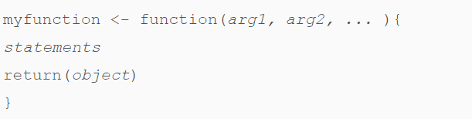
R function
function name
Built-in Function
Simple examples of in-built functions are seq(), mean(), max(), sum(x) paste(...)
User-defined Function

Slide 2
Why R function
Automate common tasks in a more general way than copy-and-pasting
Reduce incidental mistakes
Easy to update
..

Slide 3
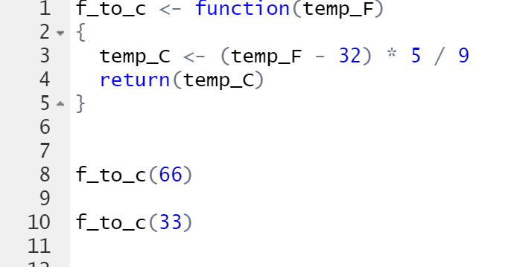
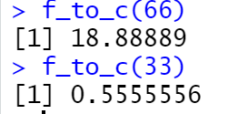
Example: fahrenheit to Celsius conversion
f_to_c <- function(temp_F)
{
temp_C <- (temp_F - 32) * 5 / 9
return(temp_C)
}
Include the R function in your main script

Slide 4
Another approach to call the function:
Save the above function as “f_to_c.R”
In your main rscript, you may include:
source(‘f_to_c.R’)
as one line of script, just like library(raster),
then you can call the function by using:
t<-f_to_c(100)

Slide 5
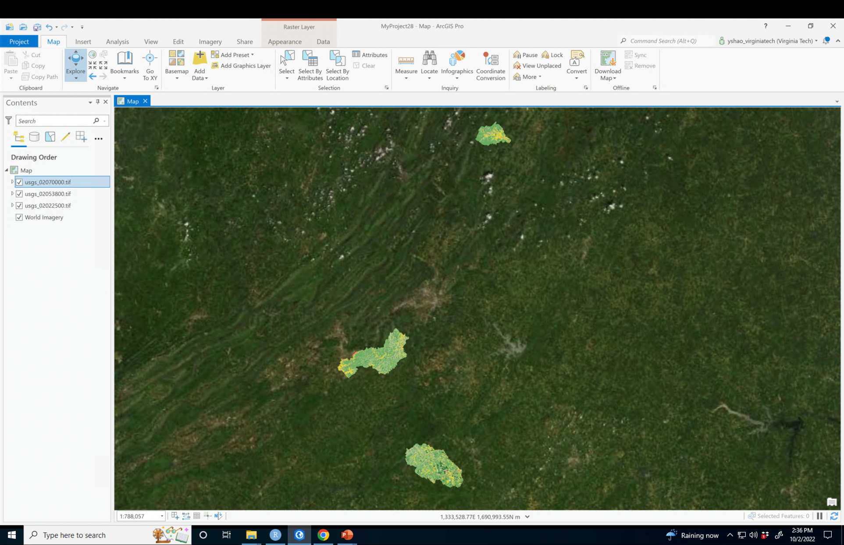
R function for a geospatial problem
Calculate %forest for watersheds (id=usgs_0207000; usgs_02053800; usgs_02022500)

Slide 6
Arguments
p_forest <- function(‘usgsid’)
{
}
Output – please print %forest for any user-defined usgs_id (or raster file name)

Slide 7
Create a spatial point
#create a spatial point feature using lon and lat
create_point <- function(lon,lat) {
# Create a point feature
point <- st_point(c(lon, lat))
# Convert to a simple feature object
point_sf <- st_sf(geometry = st_sfc(point))
# If you want the point to be in a specific Coordinate Reference System (CRS), you can set it using:
point_sf <- st_set_crs(point_sf, 4326)
return(point_sf)
}
a <- create_point(-78,38)

